Slide 1
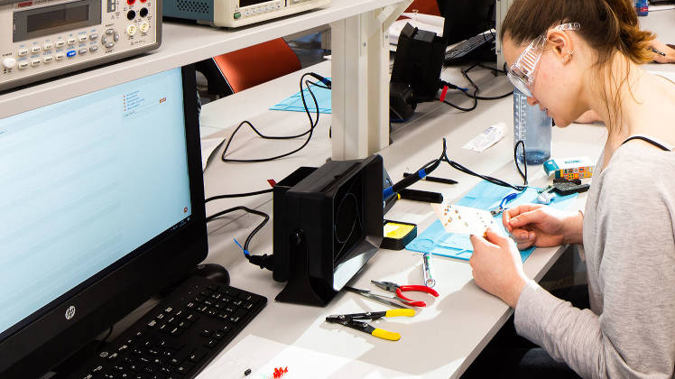
Remote Electronics Laboratories
Jack Renshaw (z5114675) UG Thesis 2021/22

Slide 2
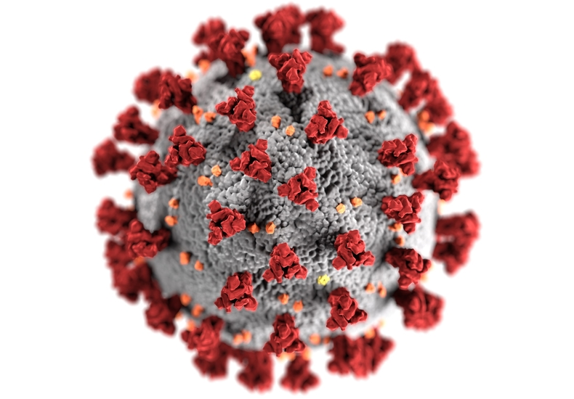
Context
Move towards remote education
Institutional Incentives
Student-Driven
HD Video Streaming, Conference Calls, Lecture Recordings
COVID-19 Accelerated the trend

Slide 3

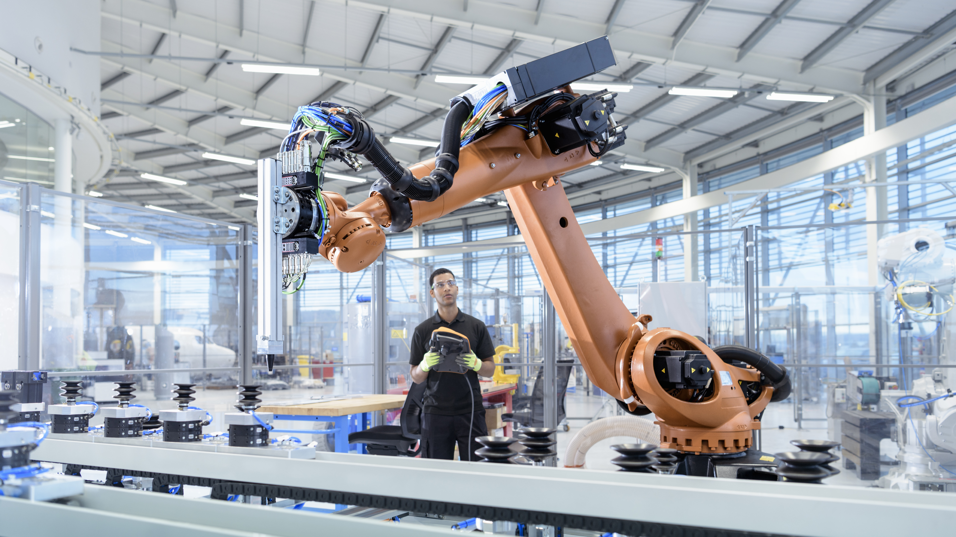



Purpose of Laboratories

Slide 4
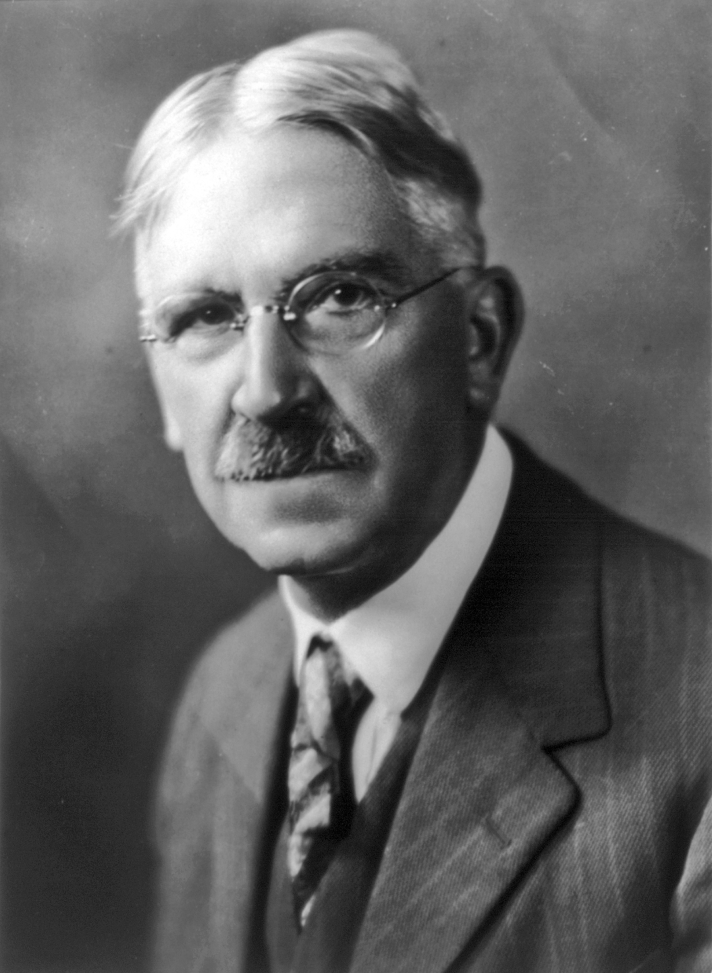
The Pedagogy of Laboratories
1.
American Philosopher and Educator John Dewey

Slide 5
Laboratories within Electronics Engineering
1.

Slide 6
A Concrete Example – Lab 1 ELEC2133
Theory and Background
1. Lab investigates non-idealities of OPAMPs (LM301A)
A. Measuring propagation delay, slew rate, bandwidth
B. Investigating the effects of an (external) compensation capacitor on the above
The lab problematizes the ‘ideal’ OPAMP by introducing real world effects Teaches students a theoretical framework for understanding the non-ideal aspects of OPAMPs (in terms of parameters) Introduces a practical method for overcoming limitations (cap compensation)

Slide 7
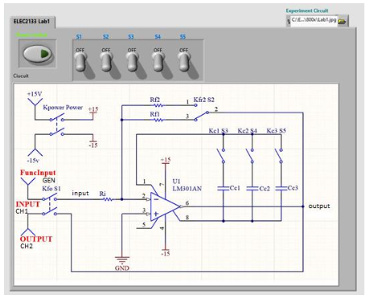
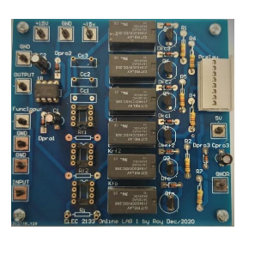


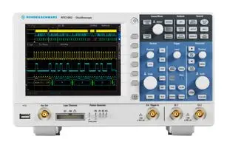
A Concrete Example – Lab 1 ELEC2133
Lab Operation
LabVIEW Interface
Lab Computer
Circuit Change
Switch Instruction
Schematic View
Settings Configuration
Oscilloscope (IP Access)
Oscilloscope Reading
Signal Output
Lab PCB

Slide 8
A Concrete Example – Lab 1 ELEC2133
Shortcomings
Circuit Schematic is simply presented to students
Schematic (vs. breadboard) view
Idealized sources (as opposed to sig-gen and PS)
Lab can be “brute forced” due to finite switches

Slide 9

Current Solutions in Academic Literature
Jack Renshaw (z5114675) UG Thesis 2021/22

Slide 10
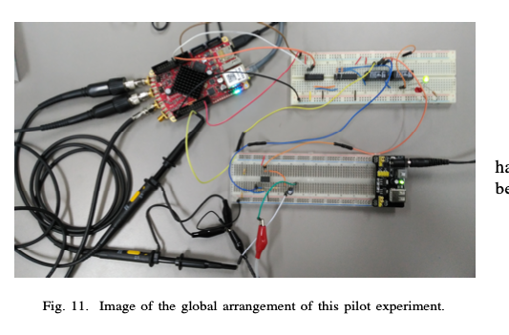
RedPitaya
Remote laboratory experiments of Analog Electronics based on ’RedPitaya’ Garcia-Orellana et al, University of Extremadura, Spain
The RedPitaya is a “Complete Package” design comprised of 3 main components on a single device. This is good example of a class of solutions to remote labs
1. Web Interface – “a file programmed in HTML and JavaScript with JQuery, which the NGINX web server [hosted on the device] sends to the client”
2. Controller – “A set of C-Programmed functions which is loaded by the web server when any communication is required [with the FGPA]
3. Hardware – The core of the device is the RedPitaya device, which contains 16 digital IO pins, ADCs, an FPGA, LED’s. Arduino on steroids.

Slide 11



RedPitaya
Remote laboratory experiments of Analog Electronics based on ’RedPitaya’ Garcia-Orellana et al, University of Extremadura, Spain
Low Cost, Reasonably Adaptable and Configurable
1. Web Interface – “a file programmed in HTML and JavaScript with JQuery, which the NGINX web server [hosted on the device] sends to the client”
2. Controller – “A set of C-Programmed functions which is loaded by the web server when any communication is required [with the FGPA]”
3. Hardware – The core of the device is the RedPitaya device, which contains 16 digital IO pins, ADCs, an FPGA, LED’s. Arduino on steroids.
Design/Hardware Aspect

Slide 12
RedPitaya
Remote laboratory experiments of Analog Electronics based on ’RedPitaya’ Garcia-Orellana et al, University of Extremadura, Spain
Hardware Concern
Does the device have the ability to measure signals up to and above the slew rate of OPAMPs?
With 8 decimal points, the sampling rate of the RedPitaya is 5.6MS/s. RTM3004 is 2.5GS/s
What are the limitations on signal generation and current?
absolute max output current is 16mA. Is this enough? We will likely need a separate supply/siggen.
Pedagogical Concern
The system out of the box doesn’t incorporate design, simply measurement and switching. The system is adaptable, so there’s scope to add this retroactively
Oscilloscope
Practical Concern
Setting up each circuit before each lab will be highly cumbersome
if the circuit is complicated. This is something STUDENTS should be doing!
It would be difficult to integrate this into the existing PCBs in an effective way
https://redpitaya.readthedocs.io/en/latest/appsFeatures/examples/acqRF-samp-and-dec.html
https://www.farnell.com/datasheets/3216075.pdf

Slide 13

Preliminary Work and Design
Jack Renshaw (z5114675) UG Thesis 2021/22

Slide 14
High Level Design

Slide 15
Thesis Plan
Jack Renshaw (z5114675) UG Thesis 2021/22

